Slide 1
Why Has There Been No Global Warming For The Past Decade?
Physics Department Colloquium
UNC Chapel Hill
September 8, 2014
William Happer
Princeton University

Slide 2
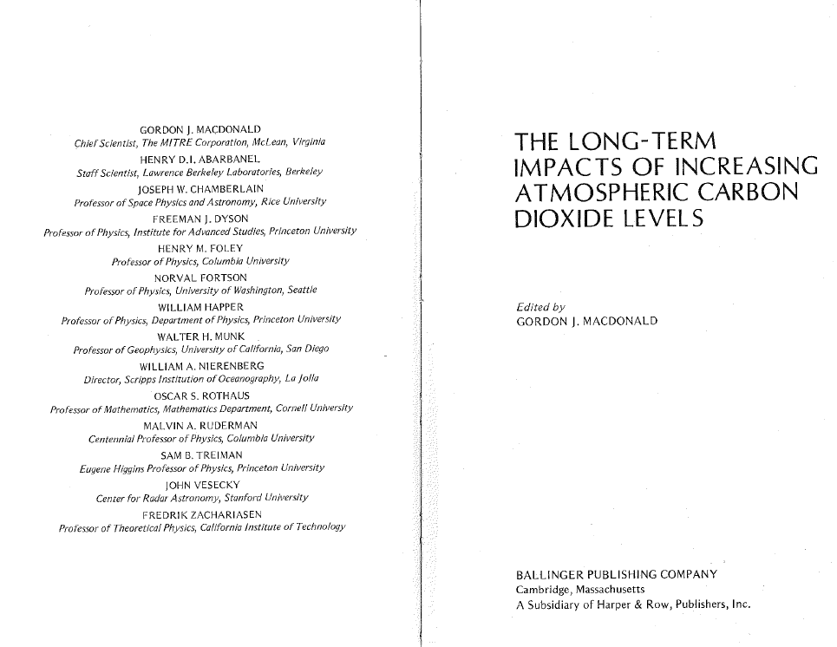
Will Happer, Climate Scientist, 1982
Notes:
Will Happer has been interested in climate for a long time. He coauthored one of the first books on climate with a number of very good scientists, including Joe Chamberlain, and expert on the Earth’s atmosphere, Walter Munk, a distinguished oceanographer, and Gordon MacDonald, a noted geophysicist.

Slide 3
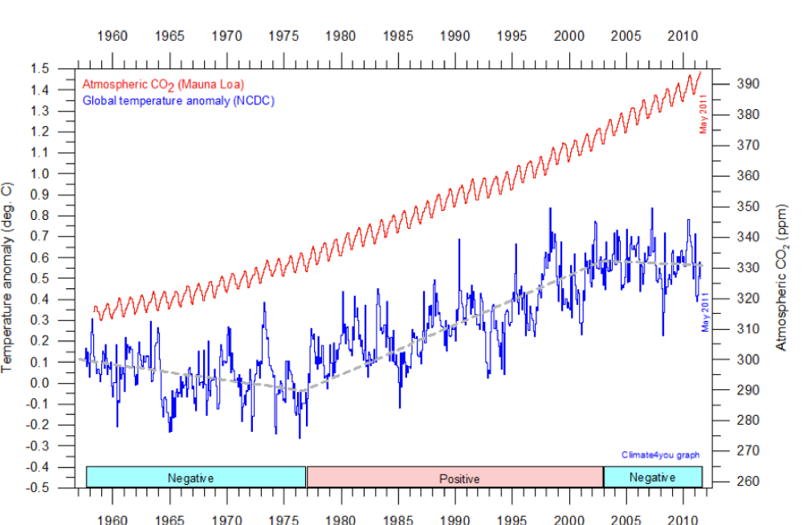
What is all the fuss about?
Notes:
The fuss is about how much global warming will come from additional CO2. As this figure shows, CO2 has been increasing steadily, and at least some of the increase is from the burning of fossil fuels, coal, oil, natural gas. This will cause some warming, but the question is how much. As you can see from this figure, the mean temperature, shown in blue, has trends that are vaguely similar to that of CO2, shown in red. But there is also a strong correlation with the phase of the Pacific Decadal Oscillation, shown on the bottom of the graph.

Slide 4
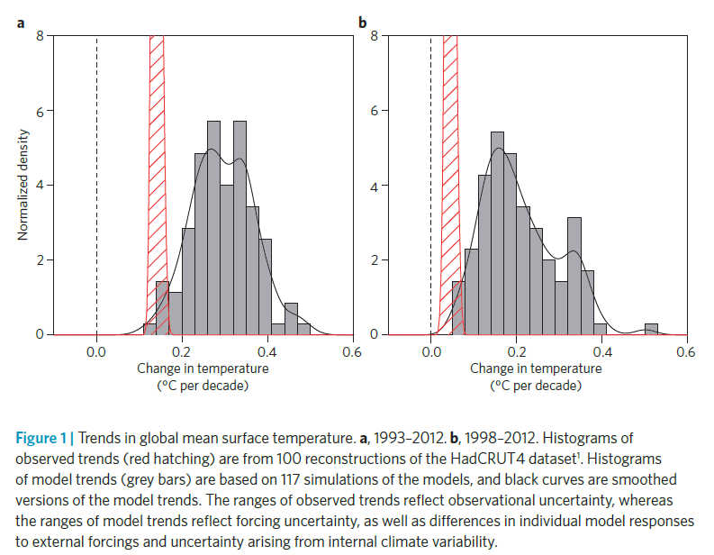
Climate Models Don’t Work; Red is Observed; Bars are Models
Happer et al., 1982
Nature Climate Change, Vol 3, p. 767, September 2013.

Slide 5
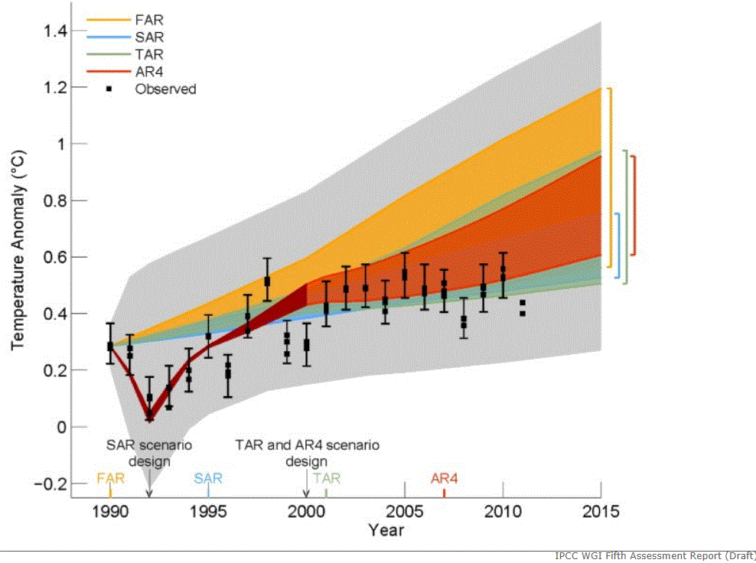
Der Spiegel, Jan. 2013
The press is beginning to notice!
Klimawandel: Forscher rätseln über Stillstand bei Erderwärmung
Notes:
Not only skeptics of global warming hysteria but even the popular press is beginning to notice that the predicted warming of IPCC models is much greater than what has been observed. This figure was published in the progressive German magazine, Der Spiegel, with the title: “Climate Change: Researchers are puzzled by the pause of global warming.” The figure, from a draft of the IPCC Fifth Assessment Report, was removed from the final version for some reason.

Slide 6
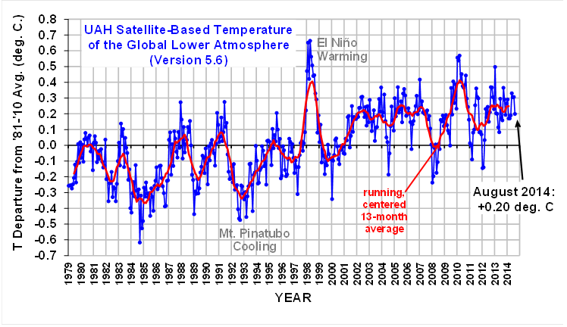
Satellite temperature measurements of
lower atmosphere show little warming
http://www.drroyspencer.com/latest-global-temperatures/
Notes:
NASA satellite measurements show little temperature rise of the lower troposphere since the big El Nino of 1998. The atmospheric temperature is deduced from the microwave (millimeter wave) thermal emission of O₂ molecules at frequencies around 60 GHz. The temperature of the lower atmosphere is strongly affected by volcanic eruptions, when high-altitude aerosols reflect so much sunlight that they cool the entire earth. The El Nino / La Nina cycle causes large changes in the surface temperature of the tropical Pacific ocean. The lower tropospheric temperatures measured by satellites should rise more rapidly than surface temperatures because of the latent heat released when water vapor of the rising air condenses into clouds.

Slide 7
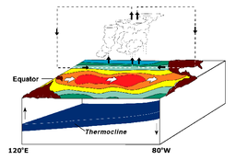
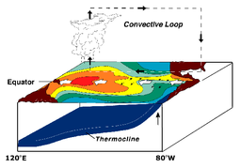
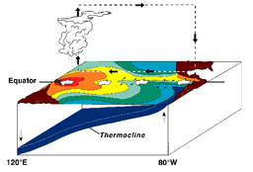
El Nino
Normal
La Nina
Notes:
The El Nino/La Nina cycle has a large effect on the average surface temperature of the earth. Under normal conditions, the easterly trade winds of the tropics push warm surface water to the western Pacific, off Australia, New Guinea and Indonesia. This produces a deep pool of warm water in the western Pacific, and it also produces an upwelling of nutrient-rich bottom water off the coast of South America. The nutrient-rich water leads to high biological productivity, including plankton, fish and birds. During an El Nino, the easterly trade winds weaken enough to allow water from the deep warm pool in the western Pacific to spread eastward toward South America. The upwelling off of the coast of South America slows and the fish catch plummets. The surface of the tropical pacific is so much warmer during an El Nino that the average surface temperature of the whole earth increases by several tenths of a degree. For tourists to South American, El Nino years are great for swimming in the ocean, which is much warmer than normal, but terrible for fishing or bird watching. La Nina conditions are the opposite extreme of the El Nino conditions.

Slide 8
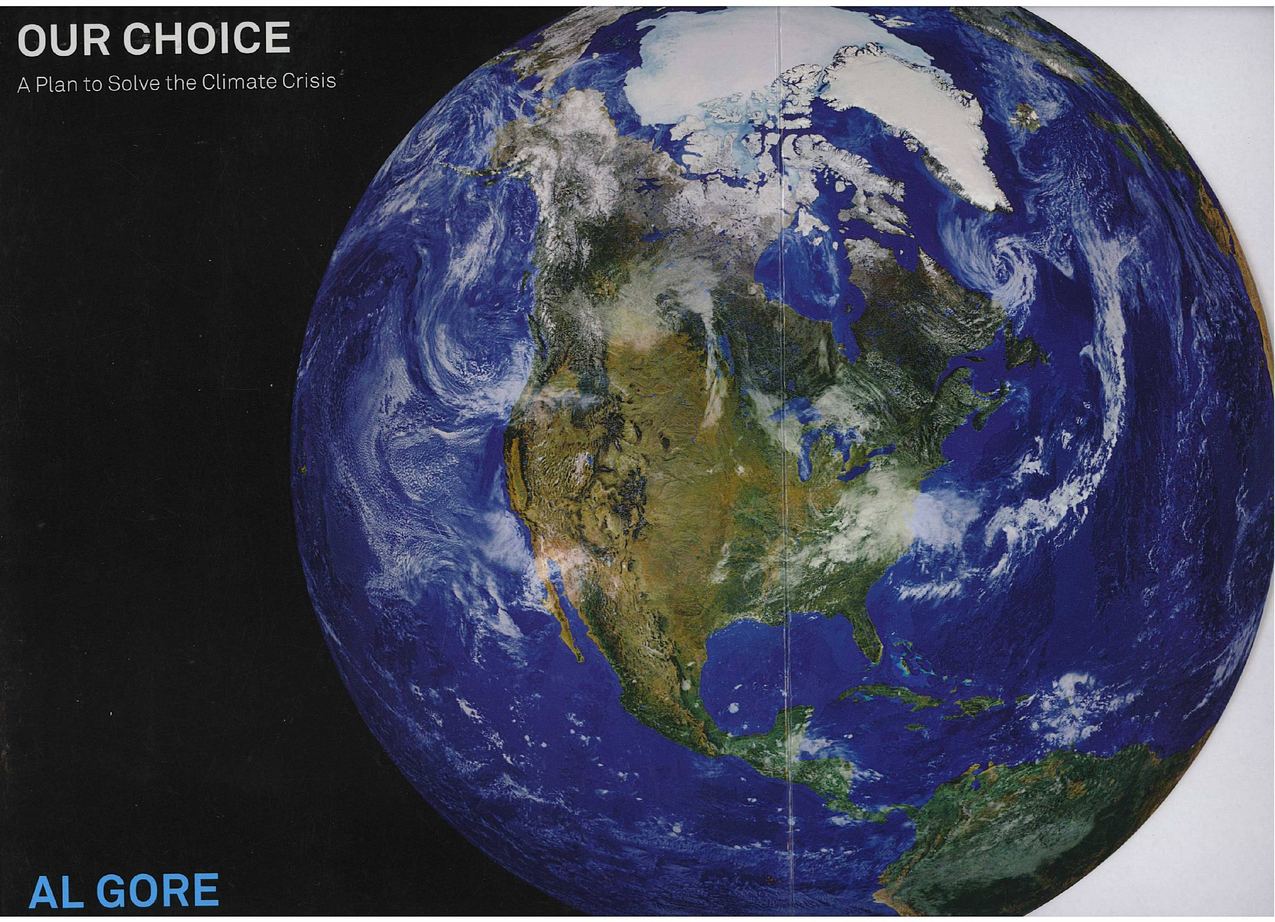
Al Gore, Climate Scientist, Nobel Laureate.
Notes:
The version of the NASA picture “retouched” by Richard Petrucci for Al Gore’s book “Our Choice,” Rodale Press, 2009
Much of the cloud cover has been removed, especially in the Arctic and South America. This belittles the enormous influence of cloud albedo on the radiative forcing of the earth.
An ice free Arctic shore of Siberia has been added, and other changes have been made to make the Arctic ocean appear to have more ice-free water.
Daylight has been added to the eastern and northern edges of the photo, which were originally in twilight or dark. We now have a perfectly “limb-brightened” earth.

Slide 9
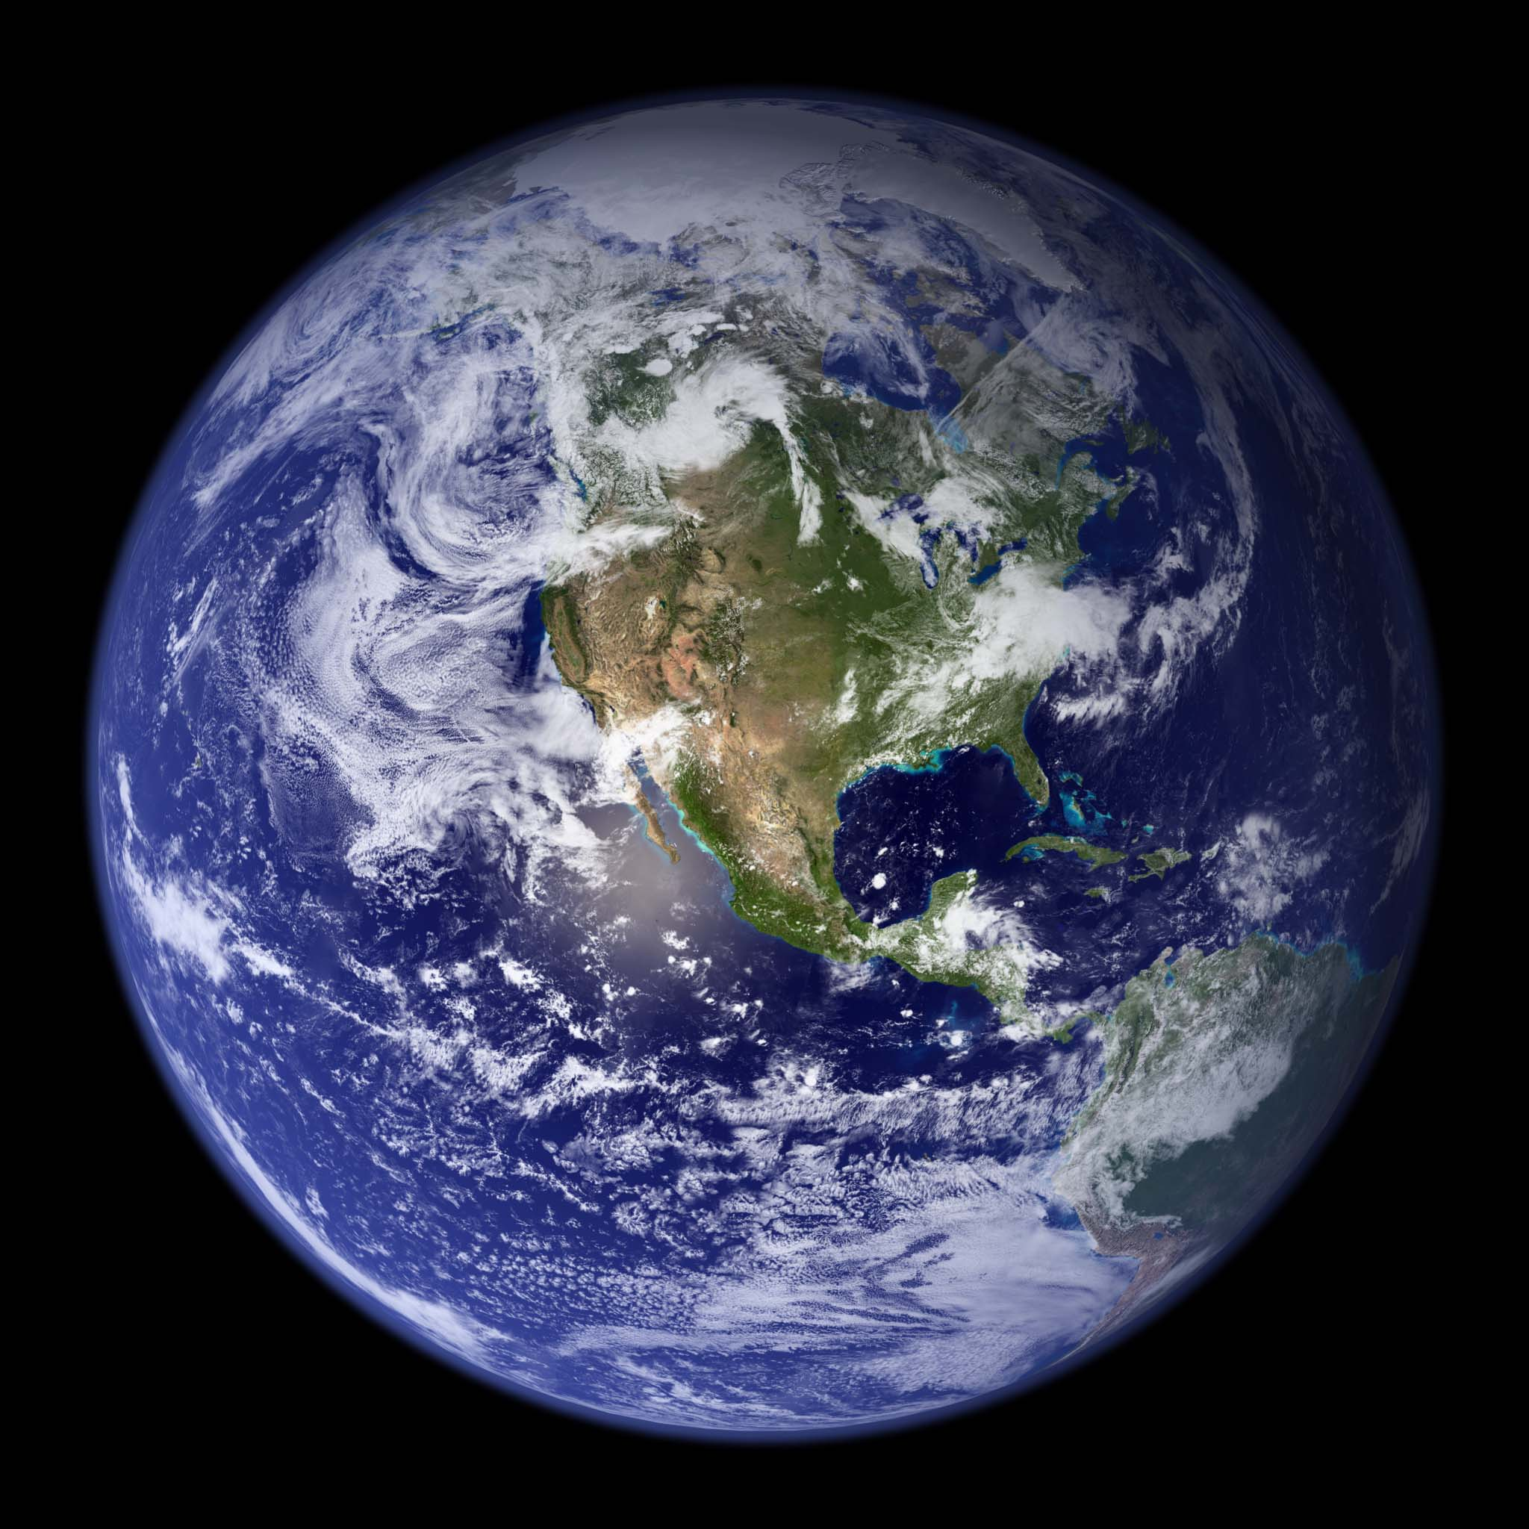
The Original for the Image on the Book’s Cover.
Notes:
http://www.google.com/#q=pictures+of+earth+from+space+nasa
From the cloud patterns, it is clear that this is the original of the cover picture of Al Gore’s book “Our Choice,” Melcher Media, New York, 2009.
See the post:
http://wattsupwiththat.com/2009/11/19/not-finding-any-gore-airbrushes-in-hurricanes-for-his-new-book/

Slide 10
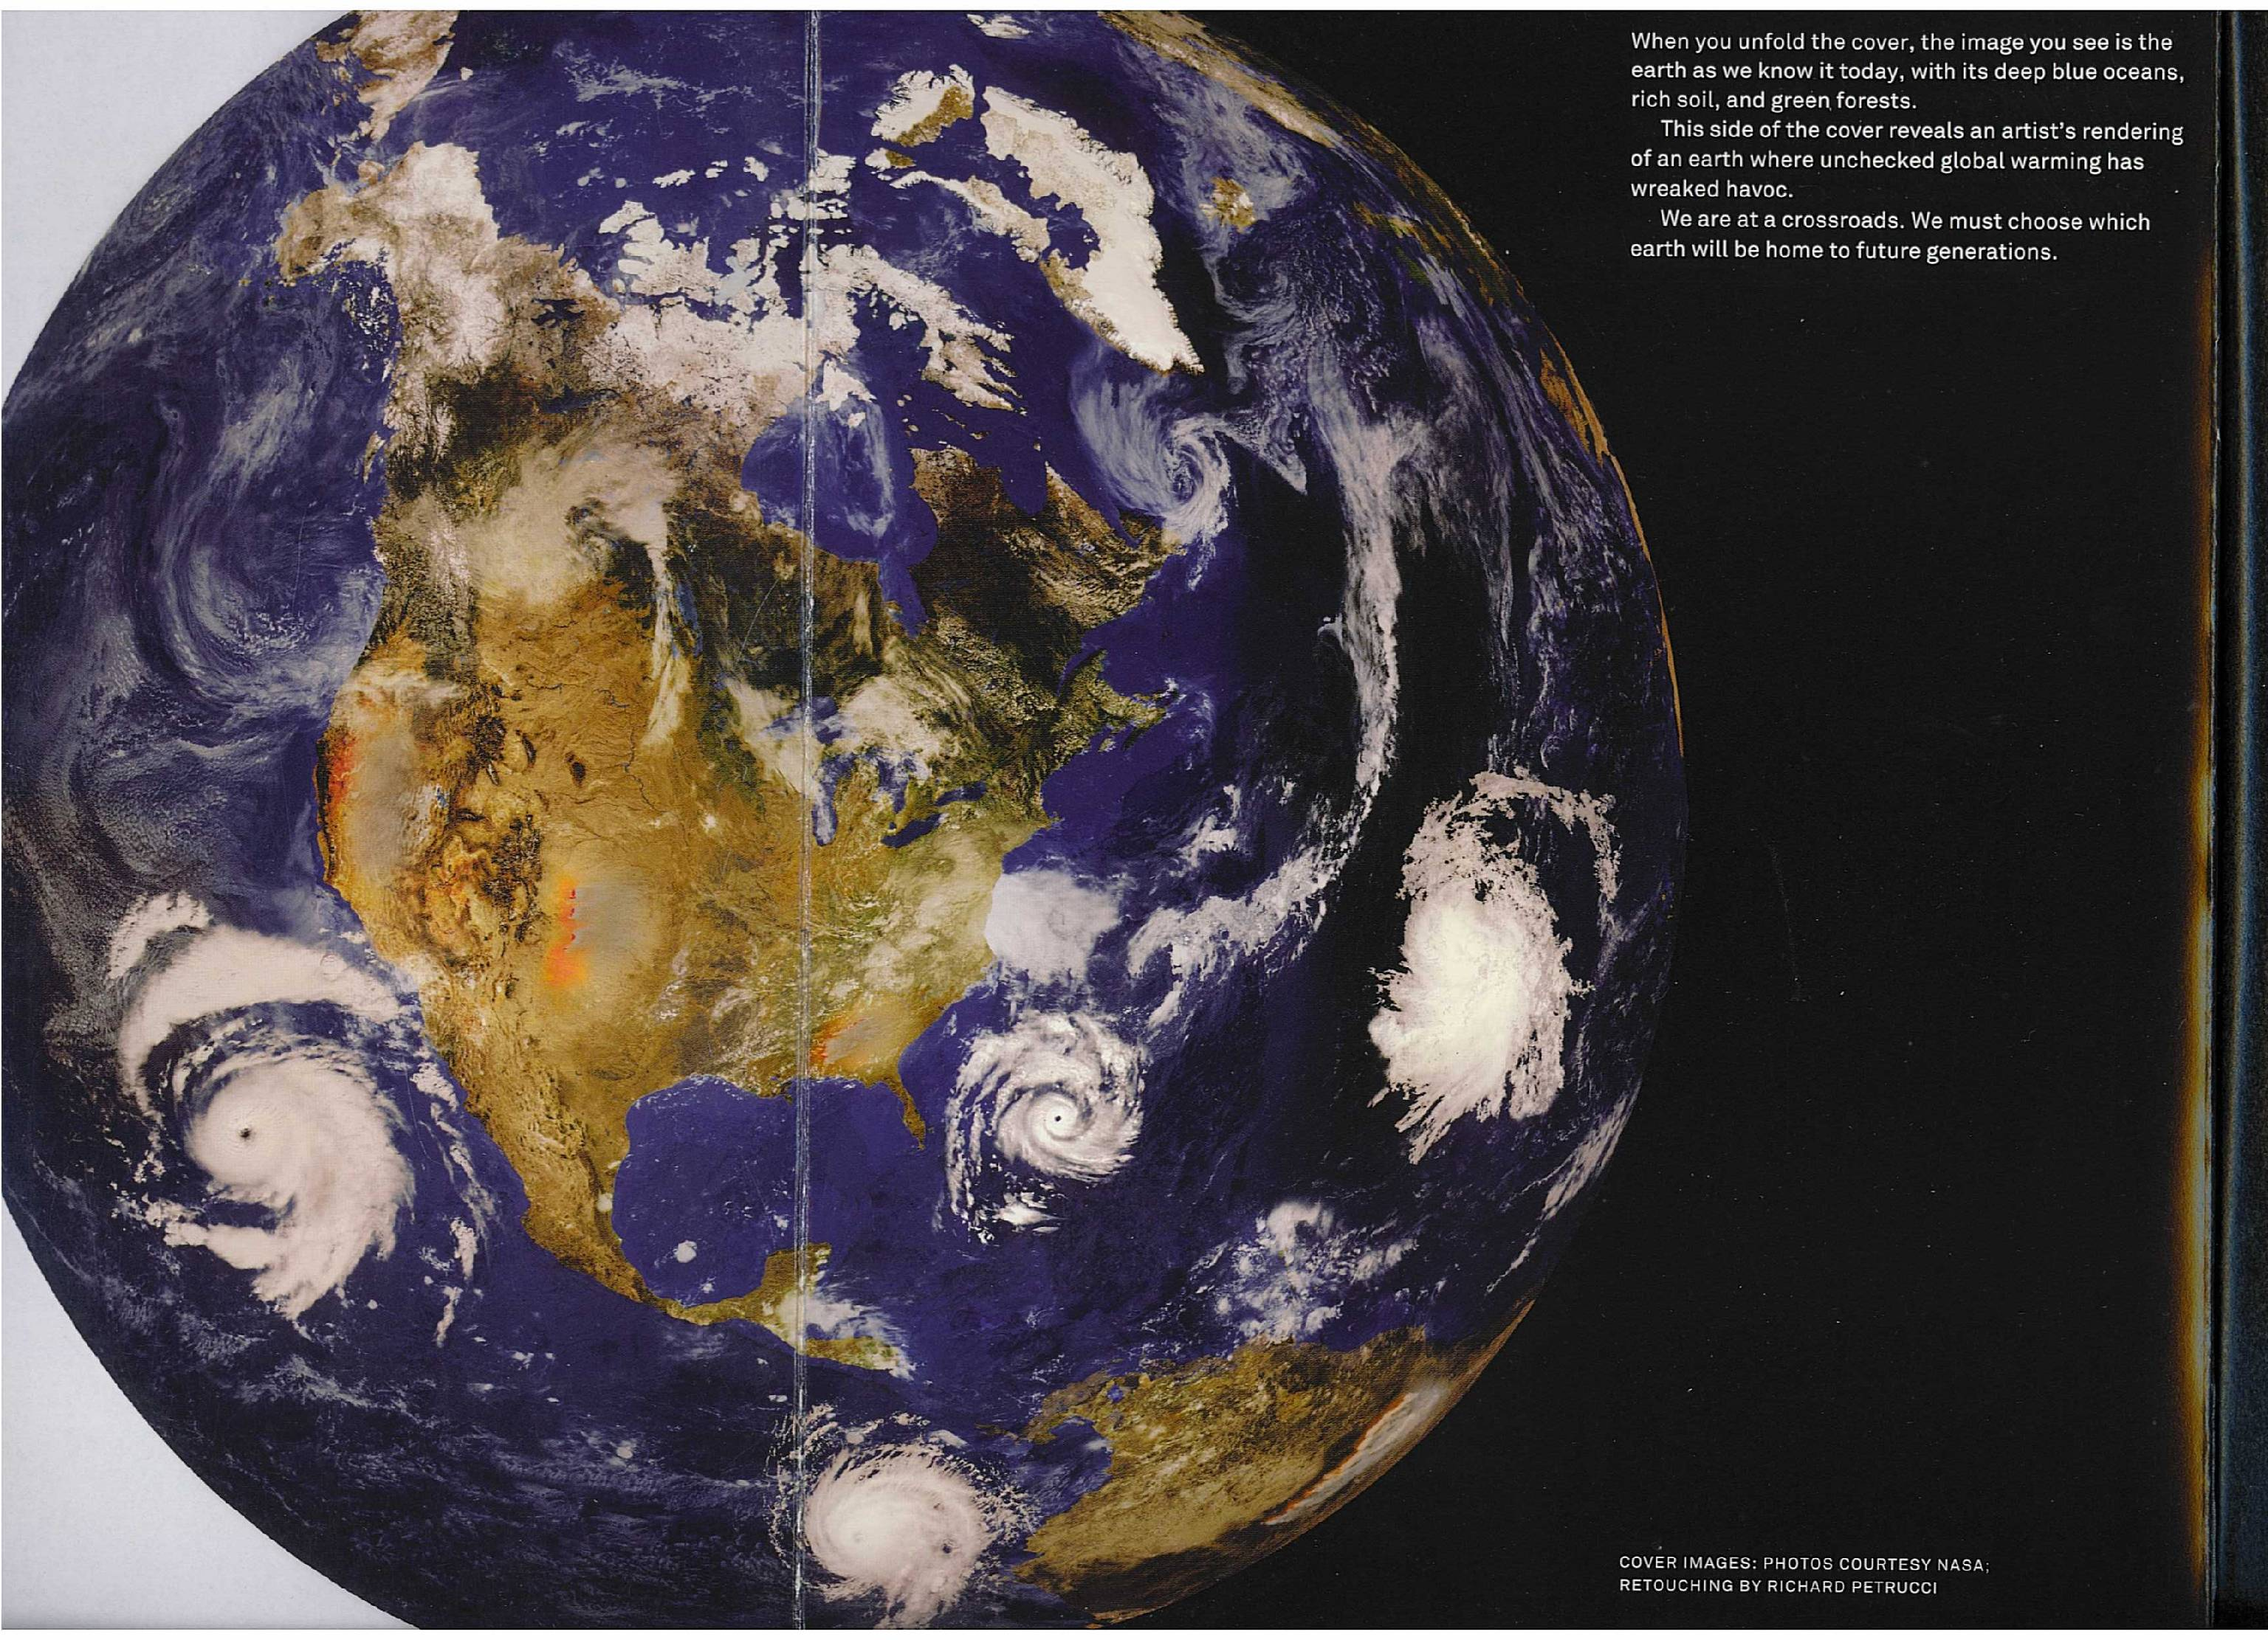
The Image on the Inner Cover Showing the Lamentable Effects of More CO2
Notes:
Al Gore’s vision of the future, the inner part of the front cover of “Our Choice,” including:
A hurricane spiraling the wrong way off the US east coast. Politicians have repealed the pesky law of conservation of angular momentum.
There is a hurricane off the equatorial coast of South America, spiraling the right way for the northern hemisphere. Before Al and his “scientists” abolished the law of conservation of angular momentum, hurricanes did not form within about plus or minus 10 degrees of the equator. The Coriolis force is zero at the equator.
The ice cover of the Arctic ocean is all gone, and a good fraction of the central part of Greenland is flooded, presumably because Al and his “scientists” looked up the current topography of Greenland. Of course you have to repeal another law of physics, isostatic glacial adjustment, which would require the currently mashed-down inland parts of Greenland to rise above sea level when the enormous weight of the ice cover is removed.
Much of Florida is under water.
Much of the US landmass is desert, including the southeast, which has somehow been transformed in to a desert in spite of getting more drenching “superstorms” like Sandy.
Except for hurricanes, there is almost no cloud cover.

Slide 11
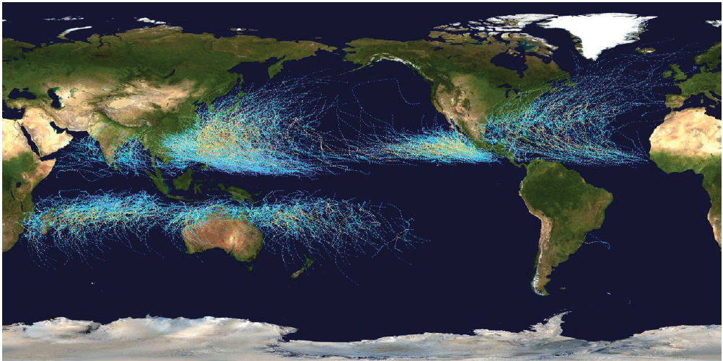
Hurricane (Tropical Cyclone) Tracks; 1985-2005; (Wikipedia)
No Coriolis force at equator → No hurricanes
Low clouds spiral in counterclockwise in North; clockwise in South

Slide 12
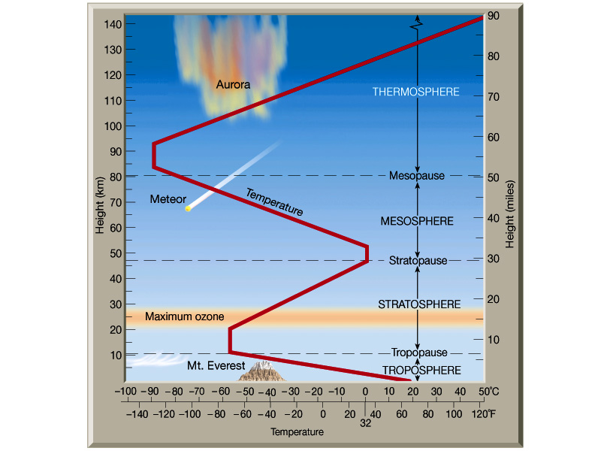
Notes:
The temperature lapse rate of the atmosphere is an important factor that affects greenhouse warming. There is a rapid drop of temperature from the surface to the tropopause, where the convective mixing of the atmosphere stops and the stratosphere begins. Although the pressure and temperature drop rapidly with increasing altitude in the troposphere, the entropy per unit mass of air is nearly constant, since it can only be decreased by the relatively slow loss of energy by radiation. With no clouds, the surface can radiate directly to space in the thermal infrared window at wavelengths around 10 microns. For wavelengths outside the atmospheric window, heat is radiated to space by H₂O, CO₂ and other greenhouse molecules and by cloud tops. The more radiation to space that comes from the thermal emission of molecules or clouds at high, cold altitudes, as opposed to radiation from the warm surface or from the relatively warm lower troposphere, the more warming of the surface there will be.

Slide 13
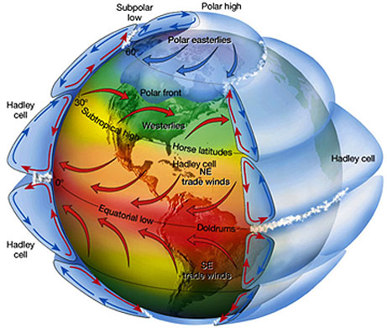
Atmospheric Circulation
Notes:
Fluid flow in the earth’s atmosphere also affects the surface temperature. Radiation into space by CO₂ and H₂O molecules cools the high-altitude branches of the enormous convective cells of air . This allows the heavier, cold (low-entropy) air to sink back to the surface of the earth. The dry air subsides at about 30 degrees latitude, north and south. These are the latitudes of the great desert belts of the earth. Because of Coriolis forces (conservation of angular momentum), the returning surface flow of air produces the easterly trade winds of the tropics, and the westerly winds of the temperate zones. Convection in the atmosphere takes heat from tropical regions to the poles and from the surface to space. The heat loss to space is entirely due to radiation from the earth’s surface and from molecules and particulates at various altitudes in the atmosphere.

Slide 14
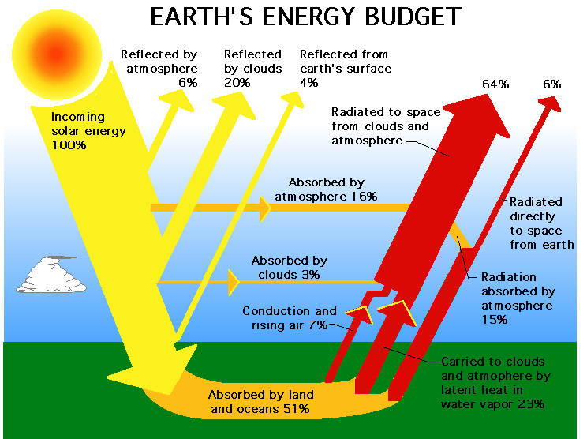
A NASA Website
Notes:
Aside from a very small amount of geothermal heat, the earth’s surface is heated by sunlight with wavelengths of order half a micron, characteristic of the 5525 K blackbody temperature of the sun’s surface. The earth’s surface is cooled mainly by convection, including cooling from the evaporation of water. The surface also cools by radiating directly to space in the thermal infrared window , with wavelengths of order 10 microns, characteristic of a blackbody with the 300 K surface temperature of the earth. Most of the thermal radiation to space does not come from the surface but from greenhouse gases, predominantly H₂0 and CO₂, and from clouds or other particulates in the atmosphere above the surface.

Slide 15
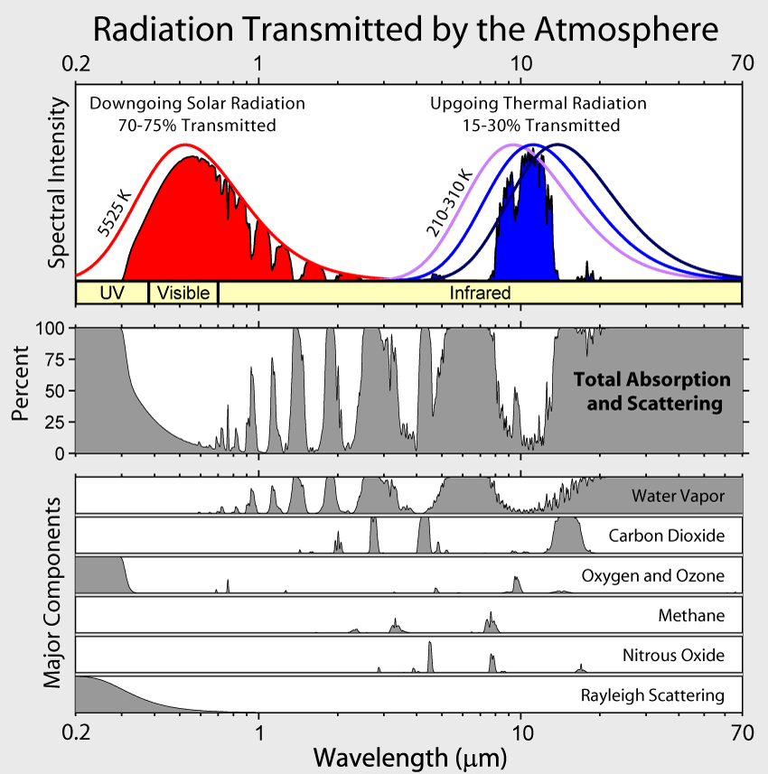
Notes:
There is substantial absorption of both sunlight and thermal radiation by the atmosphere, even in the absence of clouds. The shortest wavelengths of sunlight are subject to Rayleigh scattering, which makes our blue sky. Overtones of the vibrational modes of water molecules absorb substantial amounts of near infrared sunlight. Molecules of H₂O, CO₂, O₂, O₃ and others absorb so strongly in the thermal infrared that even for clear skies, only a narrow band of radiation with wavelengths near 10 microns can escape from the surface to space with no further scattering. Even though strongly absorbed frequencies cannot be radiated directly to space from the ground, they can be radiated to space by molecules at a sufficiently high altitude that the absorption by the air above them is negligible. This high-altitude radiation is weaker than it would be at the surface, since the air is cooler at higher altitudes than at the surface, and the molecules therefore do not radiate as strongly as they would if they were closer to the surface and warmer.

Slide 16
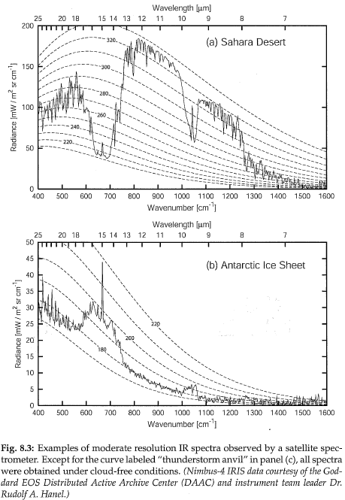
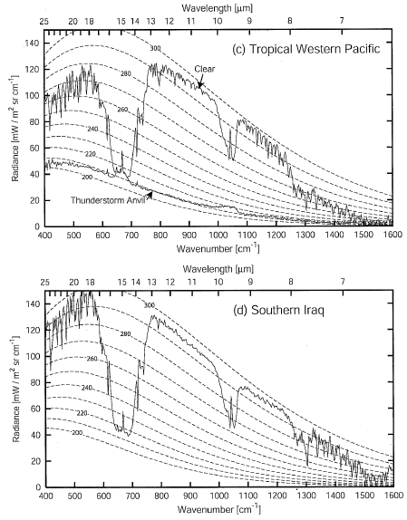
Examples of FTIR Data from a Satellite
Notes:
These are actual experimental data, obtained from a Fourier-transform spectrometer aboard a satellite. Although generally similar to the model data, the spectra are quite different at different parts of the earth’s surface. There is very little water vapor over Southern Iraq which was in dry subsiding air from the Hadley cell at the time of this measurement. There is an extreme temperature inversion over the Antarctic ice sheet, where the surface temperature is only 180 K. Over Antarctica, the CO₂ and O₂ bands show up in emission from the warmer atmosphere above the ice sheet. The atmosphere over Antarctica is so cold that it contains practically no water vapor. Finally note the near complete absence of infrared emission from the top of the thunderstorm anvil over the Tropical Western Pacific, the site of the celebrated “warm pool “ that is involved in El Nino’s and La Nina’s. The suppression of infrared radiation by high, cold cloud tops, especially cirrus clouds, is a potent global warming mechanism. However, for low clouds, the increase in visible albedo is a potent cooling mechanism.

Slide 17
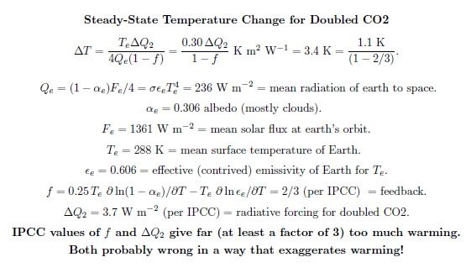
One Slide Summary of Global Warming Theory
Key Parameters: forcing ΔQ₂ and feedback f

Slide 18
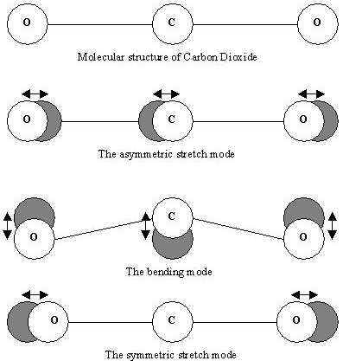
The Villain!
2349 cm ⁻¹
frequency too high for greenhouse warming
666 cm ⁻¹ (Satan’s number)
greenhouse warming
1388 cm⁻¹
no changing dipole moment,
no absorption or emission
Notes:
The CO₂ molecule has three vibrational modes: the infrared active bending mode and asymmetric stretch mode, and symmetric stretch mode, which is not infrared active. The resonance frequencies of the asymmetric stretch mode lie outside the thermal emission spectrum of the earth and also outside of most of the visible spectrum of the sun, so the asymmetric stretch mode contributes little to global warming. The frequency of the symmetric stretch mode is nearly twice the frequency of the bending mode, so there can be strong mixing of the excited bending vibration with the symmetric stretch mode. This mixing, often called Fermi resonance, since it was first explained by Enrico Fermi, makes CO₂ a more potent greenhouse gas.
Each of the strongly negative O atoms of the CO₂ molecule has a net negative charge, leaving the C atom in the middle positively charged with about half the elementary charge (the charge of a proton). It is the accelerations of these charges during the vibration and rotation of the CO₂ molecule that allows it to absorb and emit radiation. Those vibrations and rotations that produce changing electric dipole moments radiate most efficiently, very much like the whip antenna an a automobile, which also transmits and receives electric dipole radiation.

Slide 19
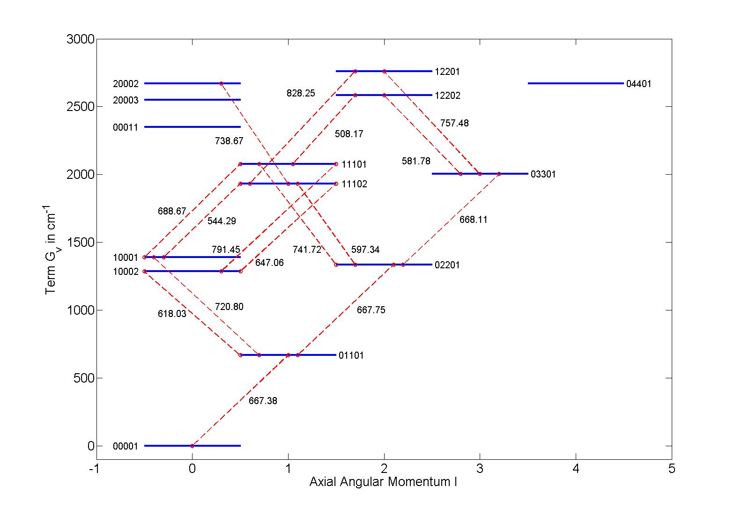
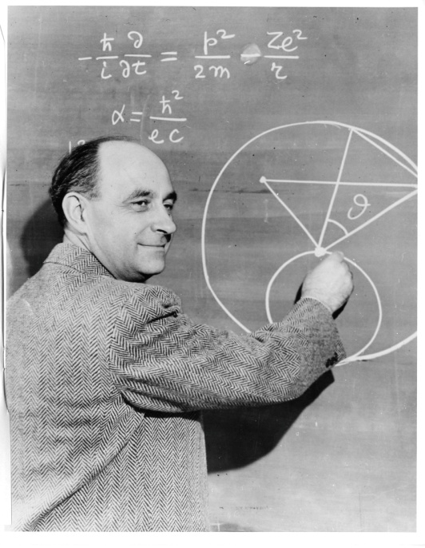
Fermi Resonances
α = ?
Notes:
The low-lying vibrational levels of the CO₂ molecule for the most abundant isotopomer ¹⁶O¹²C¹⁶O, or 626. Note the splitting of the higher bending modes by Fermi resonance interactions with the symmetric stretch mode, and with the asymmetric stretch mode. The transition frequencies for a non-rotating molecule are indicated in cm⁻¹. The states are labeled with the HITRAN code, for which the integers, reading from left to right, mean: 1) v₁ = quanta of symmetric stretch vibration; 2) v₂ = quanta of bending-mode vibration; 3) l= quanta of “vibrational” angular momentum around the axis of symmetry; 4) v₃=quanta of asymmetric stretch vibration; 5) r=ranking index for multiplets split by Fermi mixing.

Slide 20
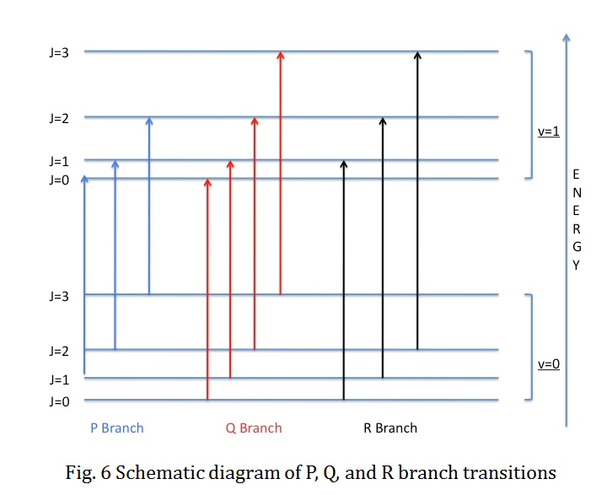
What is wrong with this slide?
Notes:
Each possible vibrational transition frequency is split into many hundreds of lines (sidebands) by the rotation of the molecule. The total angular momentum J of the molecule is a good quantum number. If J’ is the rotational quantum number of the upper vibrational state and J is the rotational quantum number of the lower vibrational state, transitions for which J’=J-1 are called P transitions, transitions with J’=J are called Q transitions, and transitions with J’=J+1 are called R transitions. For the bending mode of the CO₂ molecule, the frequencies of the Q transitions, which corresponds to rotation of the molecule around the axis of transverse vibration, have little dependence on the rotational quantum number J of the lower state, are nearly the same as for a non-rotating molecule. The P and R transitions have lower and higher frequencies, respectively, than the non rotating molecule, and the frequencies depend strongly on the rotational quantum number J of the lower state.
This sketch shows transitions between two vibrational states with axial angular momentum L = 0, for example, for the asymmetric stretch state of the CO₂ molecules where the electric dipole moment is along the symmetry axis. For the bending mode of CO₂, that contributes to global warming, the electric dipole moment is perpendicular to the symmetry axis, and the axial angular momentum quantum numbers, L’ and L, of the upper and lower states must differ by one unit, that is L’= L + 1 or L’= L - 1, as illustrated on the previous slide. If the O atoms are identical, the states L = 0 and odd J are missing because of exchange symmetry. States with nonzero L and non-identical O atoms are narrow parity doublets.

Slide 21
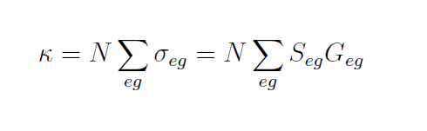


Attenuation Coefficient (e-foldings / length)
Line shape
N is the number density of CO₂ molecules, and σ_{eg} is the cross section of the transition from a lower state g to an upper state e; G_{eg} is the lineshape function.
Line strength (in cm)
ν_{eg} = frequency (in cm⁻¹) of the transition, D_{eg} = the electric dipole matrix
element, E_{g} = lower-state energy, T = absolute temperature, k = Boltzmann’s
constant, h = Planck’s constant, c = speed of light, T = absolute temperature.
Partition function
Notes:
The important line strength factor S_{eg} is a bit like a temperature-dependent “oscillator strength.” It takes into account both absorption and stimulated emission of molecules that are in thermal equilibrium at a temperature T. Since it is not possible to calculate the matrix element D_{eg} of the electric dipole moment with sufficient accuracy for them to be of use in modeling the greenhouse effect, line strength factors are measured and tabulated, often at a reference temperature of 296 K, as in the HITRAN data base.
To get absorption cross sections it is necessary to have line shape factors G_{eg} as well as line strength factors. The line strength factors S_{eg} have been determined very well by experiment. The line shape factors G_{eg} have been determined experimentally to be very nearly Lorentzian (or Doppler-broadened Lorentizian = Voigt profiles) near line centers, but very little is known experimentally about the far wings of the profiles.

Slide 22



Normalized line shapes
A Lorentzian line shape
μ_{eg} = broadening; ν = frequency; ν_{eg} = resonance.
A Voigt line shape
Neither Lorentzian nor Voigt line shapes are correct in the far wings!
Notes:
The intrinsic line shapes of vibration-rotation transitions of the CO₂ molecule in the earth’s atmosphere are almost completely determined by collisions, except for the high stratosphere where Doppler broadening of the lines is no longer negligible, and one should use a Voigt profile near line center.

Slide 23
Thousands of lines! Linestrengths vary by 10 orders of magnitude.

Slide 24
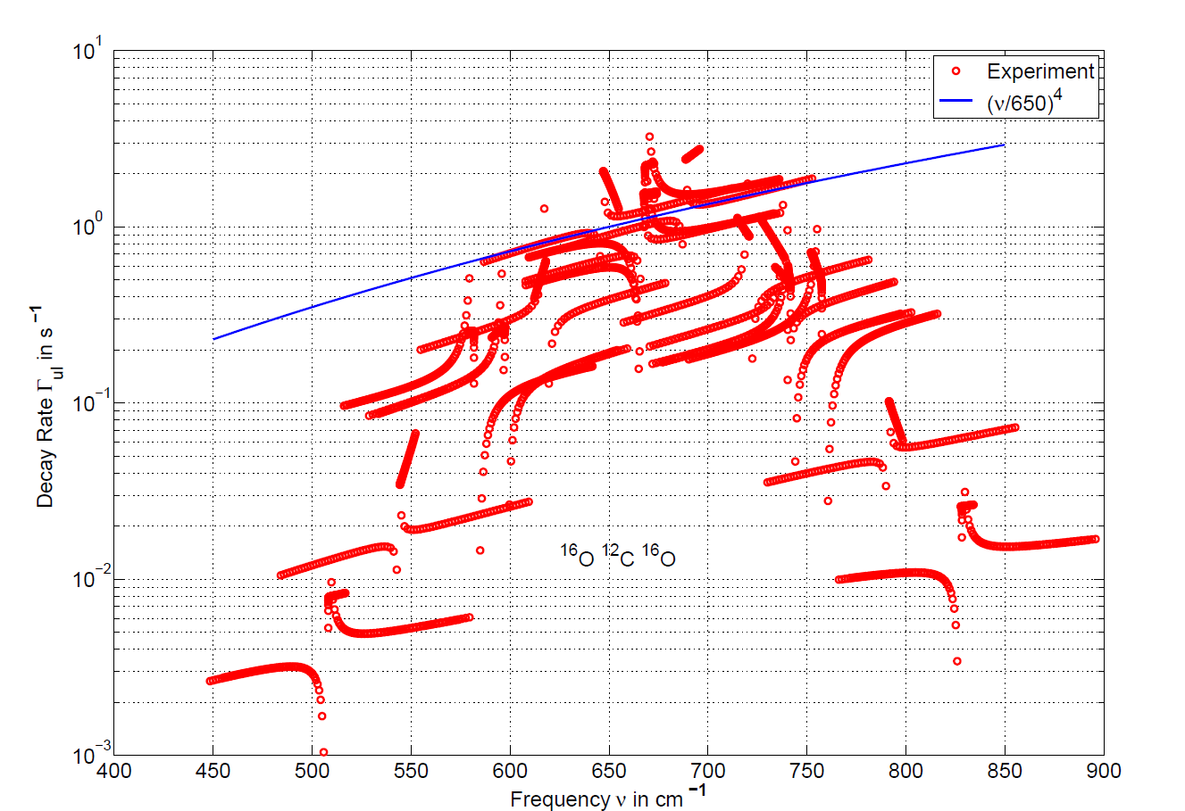
Very Slow Partial Radiative Decay Rates of CO2 Molecules

Slide 25
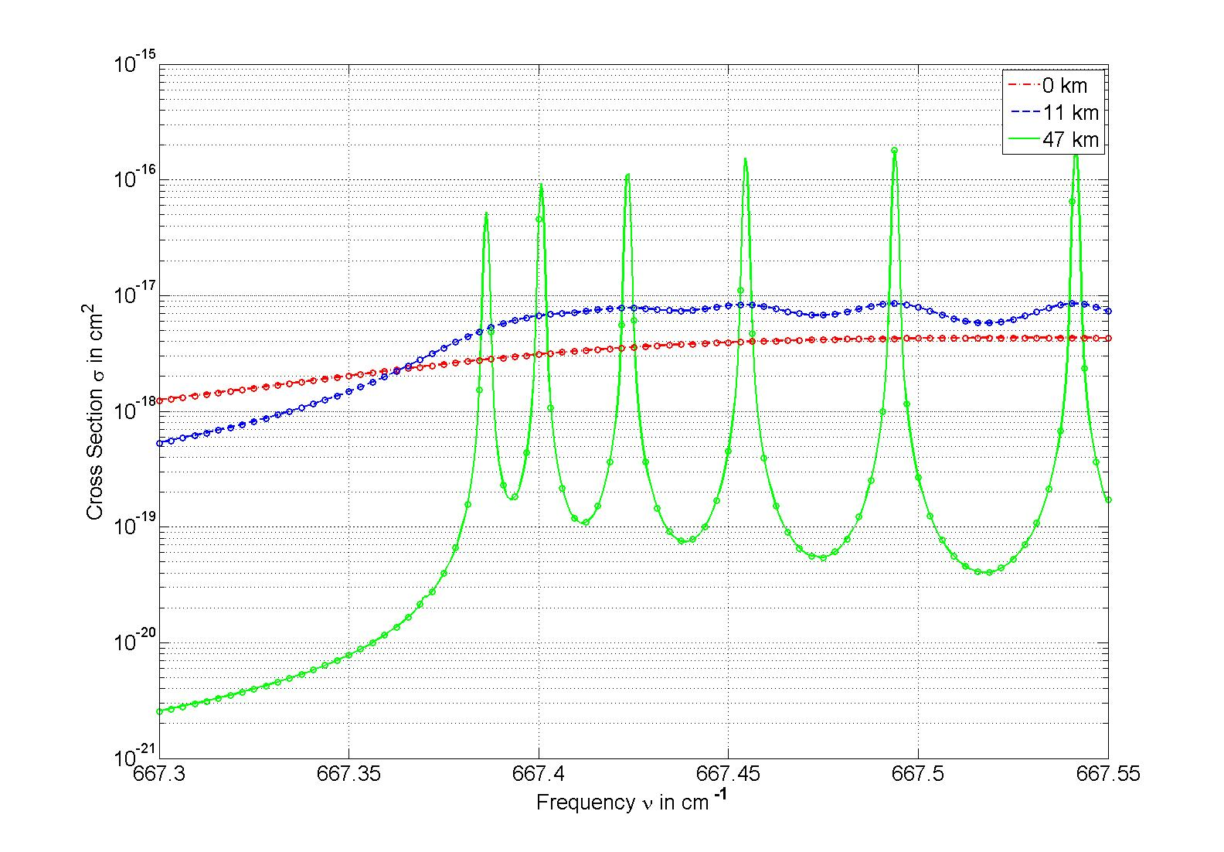
Less pressure broadening of cross sections at high altitude. Q-branch lines.
Notes:
This is a fine-scale plot of the absorption cross section for CO₂ near the very center of the 667 band. The resonances are for Q-branch (J’-J=0) transitions from rotational states with angular momentum quantum numbers J = 0, 2, 4, … of the ground vibrational level to the first excited vibrational level of the the most abundant isotopomer ¹⁶O¹²C¹⁶O or 626. Because the O nuclei are identical bosons, the rotational levels with odd J are missing. Pressure broadening at the earth’s surface smears out the resonance lines, but they are well resolved at the top of the stratosphere, 47 km, where the pressure is only a few millibar. The continuous lines are for Voigt profiles, and the points are Voigt profiles with suppressed wings. Wing suppression makes no difference at the center of the absorption band.

Slide 26
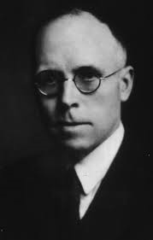
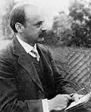


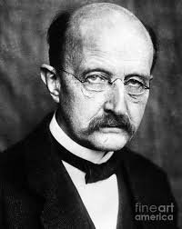

Schwartzschild-Milne Equation:
Downwelling Flux at the Surface
Optical Depth from Surface
to Altitude z
K. Schwartzschild
E. A. Milne
Planck Brightness
M. Planck
Notes:
The basic radiative transfer equations describe the net effect of spontaneous and stimulated emission and of absorption by molecules. Quite similar equations describe the gain of lasers, where the distribution of the molecules over the quantized energy states is far from thermal equilibrium and one can get gain.

Slide 27
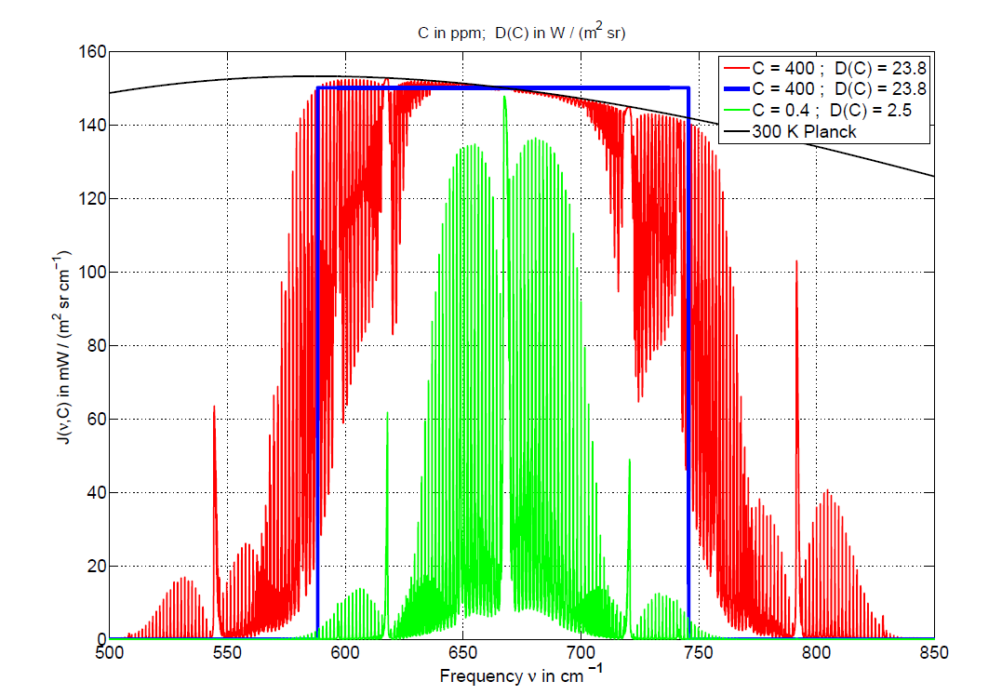

Slide 28
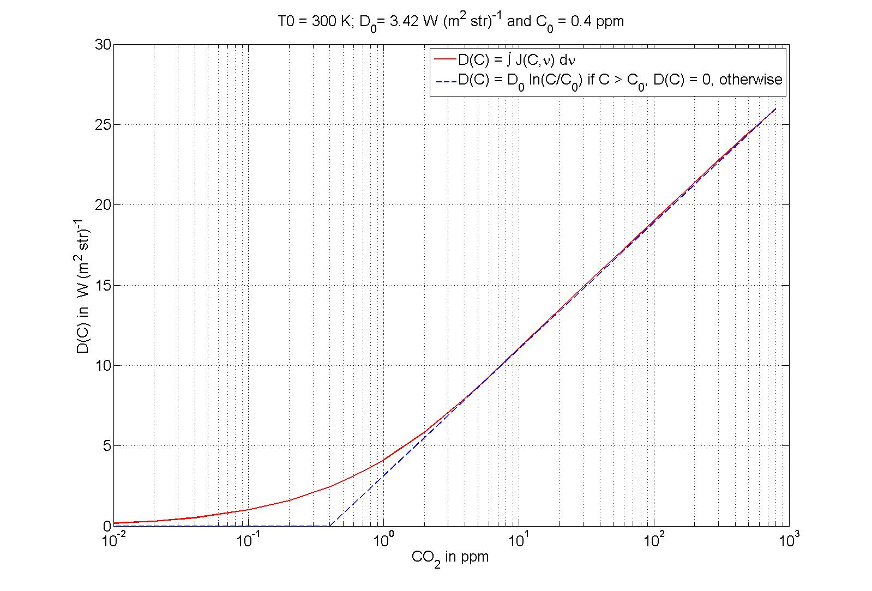
Logarithmic dependence of down-welling IR on CO₂ concentration.

Slide 29
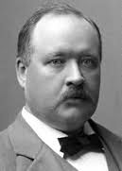
Logarithmic Dependence of Warming on CO₂ Concentration
Svante Arrhenius
Worlds in the Making, The Evolution of the Universe
(page 53)
“If the quantity of carbon dioxide in the air should sink to one
half its present percentage, the temperature would fall by
4 K; a diminution by one-quarter would reduce the temperature
by 8 K. On the other hand any doubling of the percentage of
Carbon dioxide in the air would raise the temperature of the
Earth’s surface by 4 K, and if the carbon dioxide were increased
four fold, the temperature would rise by 8 K.”
C = CO₂ concentration; C₀ = saturation concentration; S = Doubling Sensitivity

Slide 30
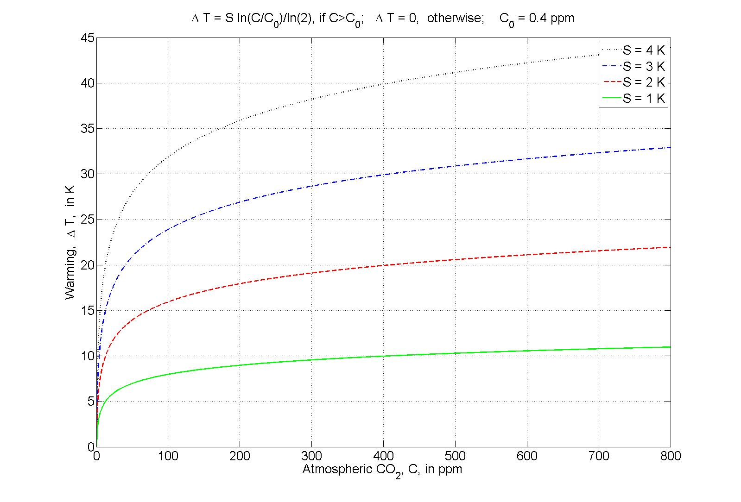
The doubling sensitivity S for greenhouse warming by CO₂ is poorly known.
IPCC claims S = 1.5 K to 4.5 K.
Could be even smaller!

Slide 31
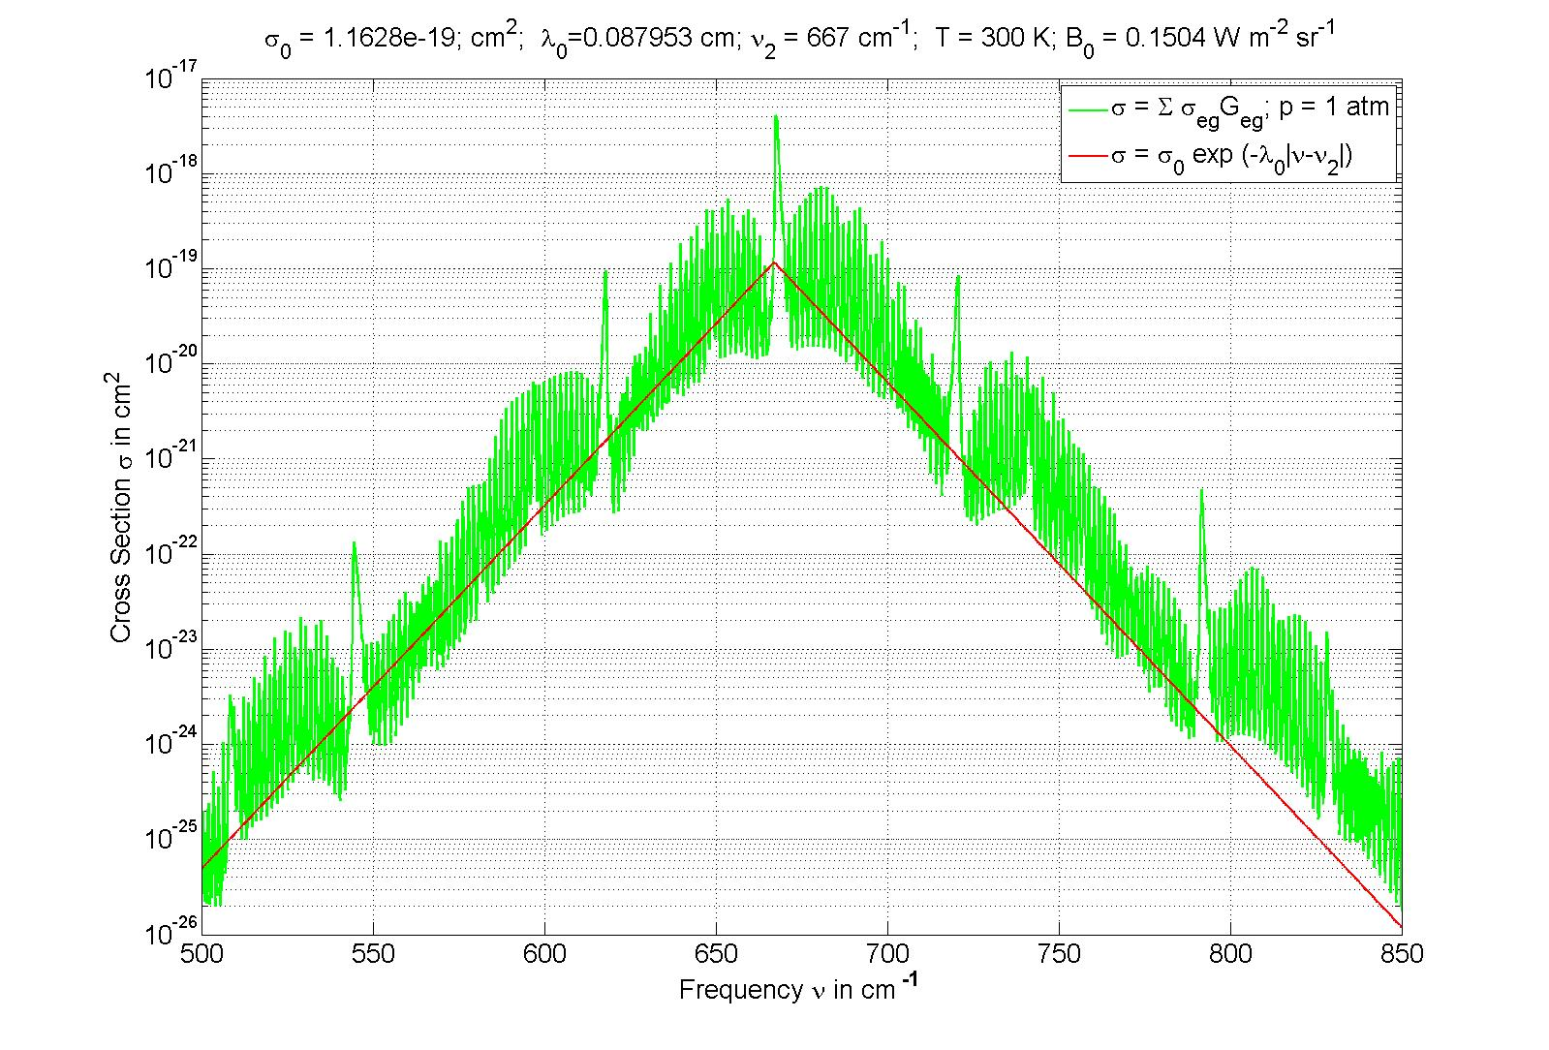
Triangular Approximation to CO2 Cross Section Give Logarithmic Warming
D. J. Wilson and J. Gea-Banacloche, Am. J. Phys. 80, 306 (2012)

Slide 32
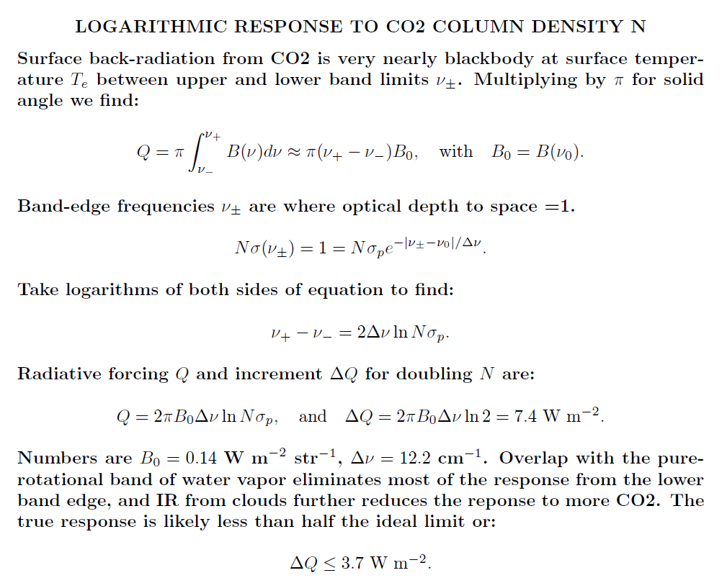

Slide 33
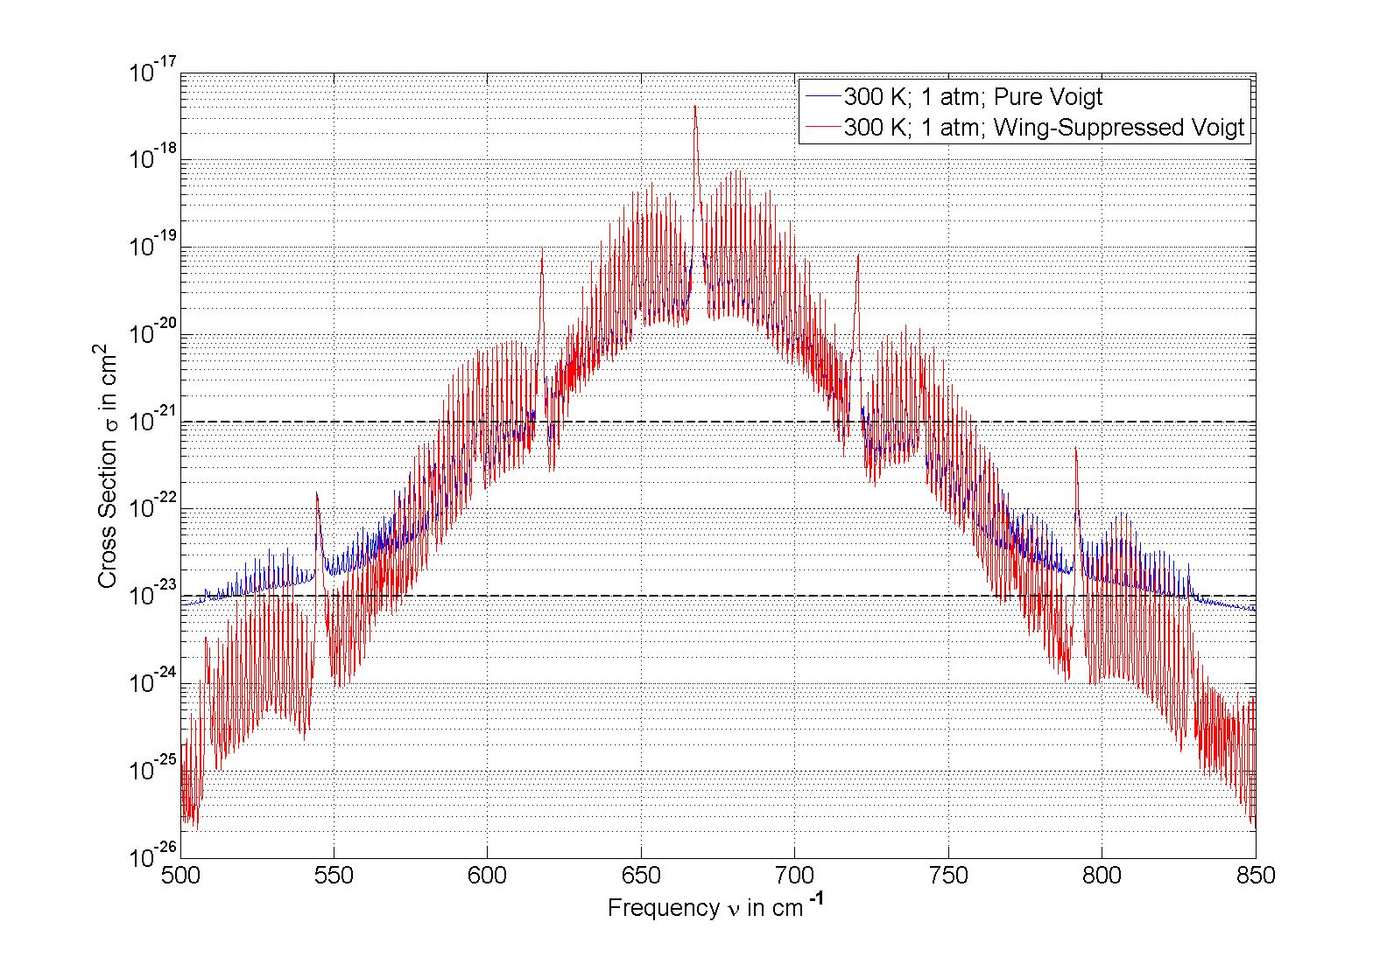
Cross sections depend on far-wing lineshape at band edges which drive warming!
Notes:
Assuming Voigt line shapes greatly overestimates the net CO₂ cross section in the wings of the band. Cross sections with value between 10⁻²³ and 10⁻²¹ cm² are responsible for almost all of the greenhouse warming from additional CO₂. Current column density of CO2 is 8.6 x 10^{21} cm^{-2}.

Slide 34
Physics Behind Shape of Emission Absorption Lines
Radiative decay
(line core).
Free-oscillation time
between collisions
(line core).
Doppler shift
from molecular
motion (line core).
Collisional
excitation/deexcitation
transients (far wings).

Slide 35
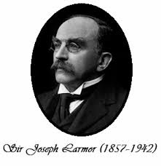
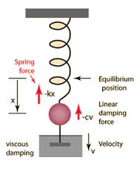
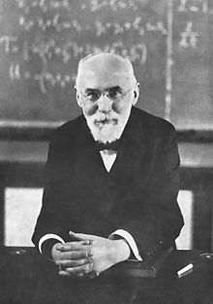
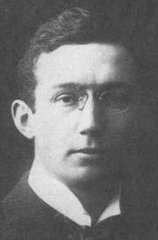
Radiation
(Pre-QM Fermi’s Golden Rule)
Larmor’s radiated power
The Larmor time
Viscous damping
does not work as
a description of
radiation damping.
It does not conserve
energy. Radiation
damping force must
be proportional to
the third deriviative!
The Abraham-Lorentz radiation reaction force
(see Jackson’s E&M for more discussion)
H. A. Lorentz (1853 -1928)
Newton’s second law of motion
M. Abraham (1875 – 1922)

Slide 36
A Solution to Newton’s Second Law, f = ma

Slide 37
A Useful Special Function For Spectral Line Shapes

Slide 38

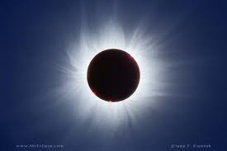
Collision-Free Cross Section (not possible with CO₂ in air) :

Slide 39
Outline of Lineshape Calculation with Collisions

Slide 41
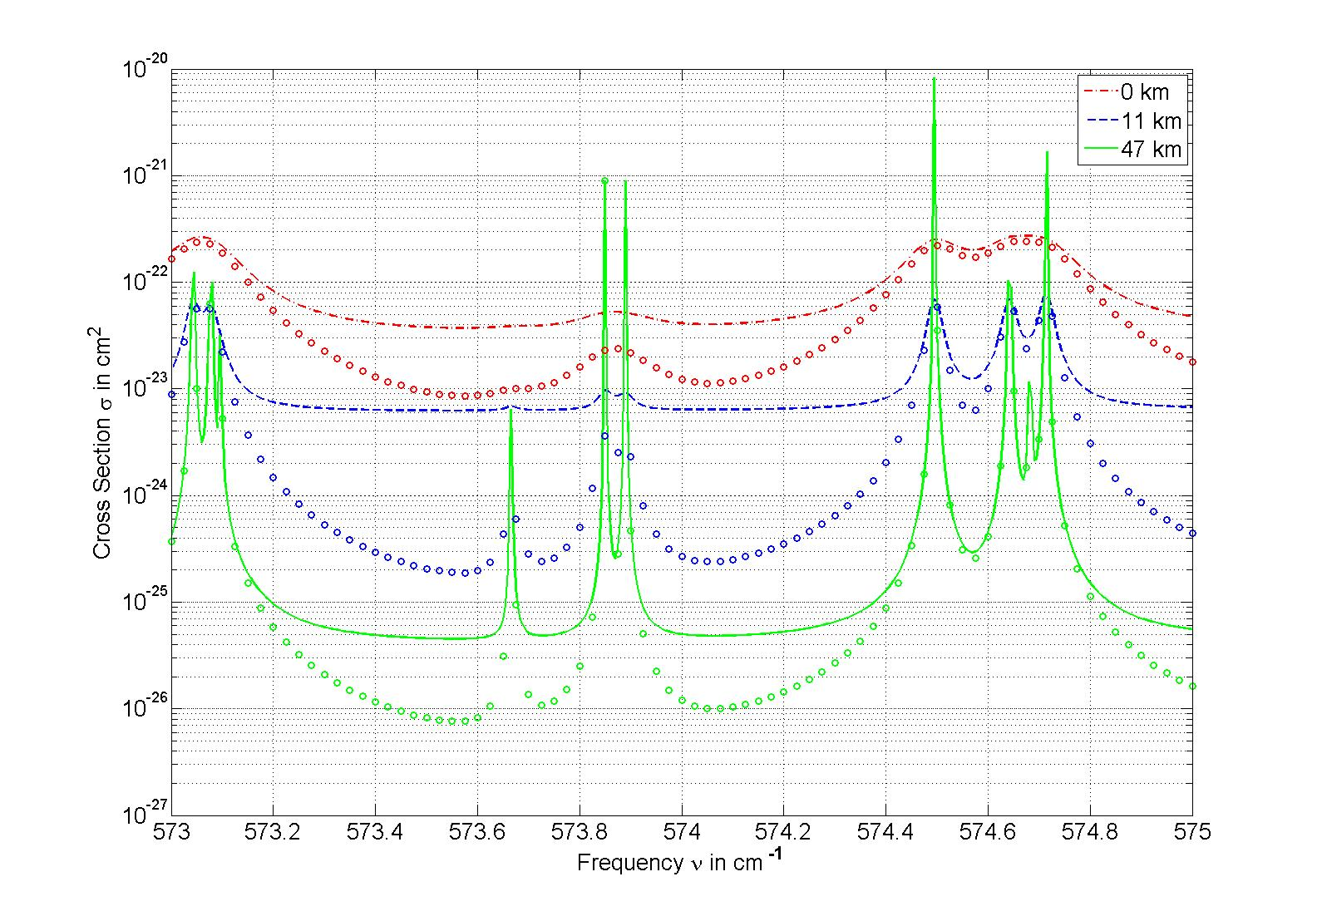
Far-wing (global warming) cross sections much bigger with Lorentz broadening ( lines)
than with realistic far-wing broadening (circles).
Notes:
Cross sections in the wings of the 667 absorption band of CO₂. Much of the absorption between resonance lines comes from the wings of the strong lines near the center of the band. The continuous curves are for Voigt profiles and the points are for wing-suppressed Voigt profiles. Most of the resonance lines are for P (J’-J=-1) and R (J’-J=1) transitions out of high vibrational states of the most abundant isotopomer ¹⁶O¹²C¹⁶O or 626, but the weak resonance at 573.666 comes from the next-most abundant isotopomer ¹⁶O¹³C¹⁶O or 636.

Slide 42
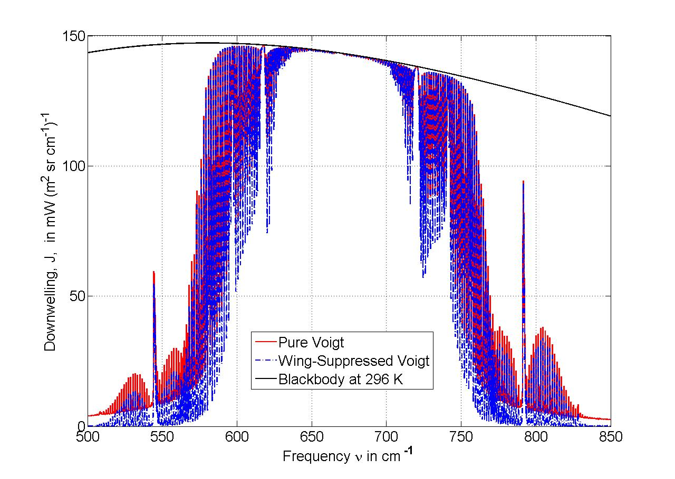
390 ppm CO₂
Notes:
This is a modelled downwelling spectrum at the earth’s surface. It comes from CO₂ in a cloud-free atmosphere with no other greenhouse molecules, notably no H₂0. The assumed line profile makes very little difference near the center of the band, but it makes a big difference in the far wings. The assumed CO₂ concentration, 390 ppm, is close to today’s value.

Slide 43
Using Voigt profiles increases
the radiative-forcing increment
from doubling CO₂ by a factor
~1.4
But far wing absorption from Voigt
profiles does not exist!
Need experimental measurements!

Slide 44
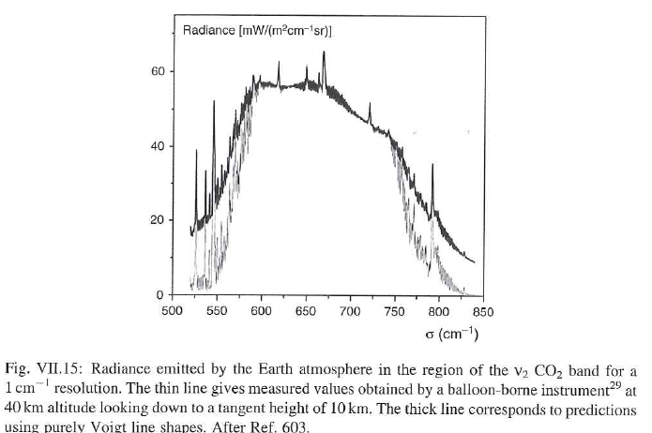
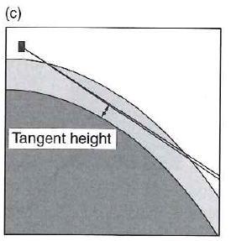
Voigt Line Shapes Don’t Work in Far Wings!
Hartmann, Boulet and Robert, Collisional Effects on Molecular Spectra, Elsevier, 2008
Notes:
The inadequacies of the Voigt profile for far-wings of the CO2 band have already been demonstrated experimentally many times. A recent example is the balloon observations cited in the recent book by Hartmann et al.

Slide 45
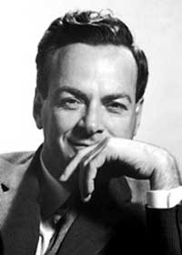
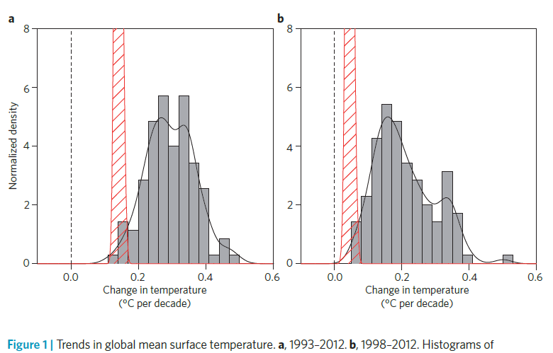
Climate models are not working! Far-wing lineshapes (forcing ΔQ₂) are one of many possible causes. Clouds (feedback f) probably even more important
“Science is the belief in the ignorance of experts.”
Richard Feynman

