Slide 1
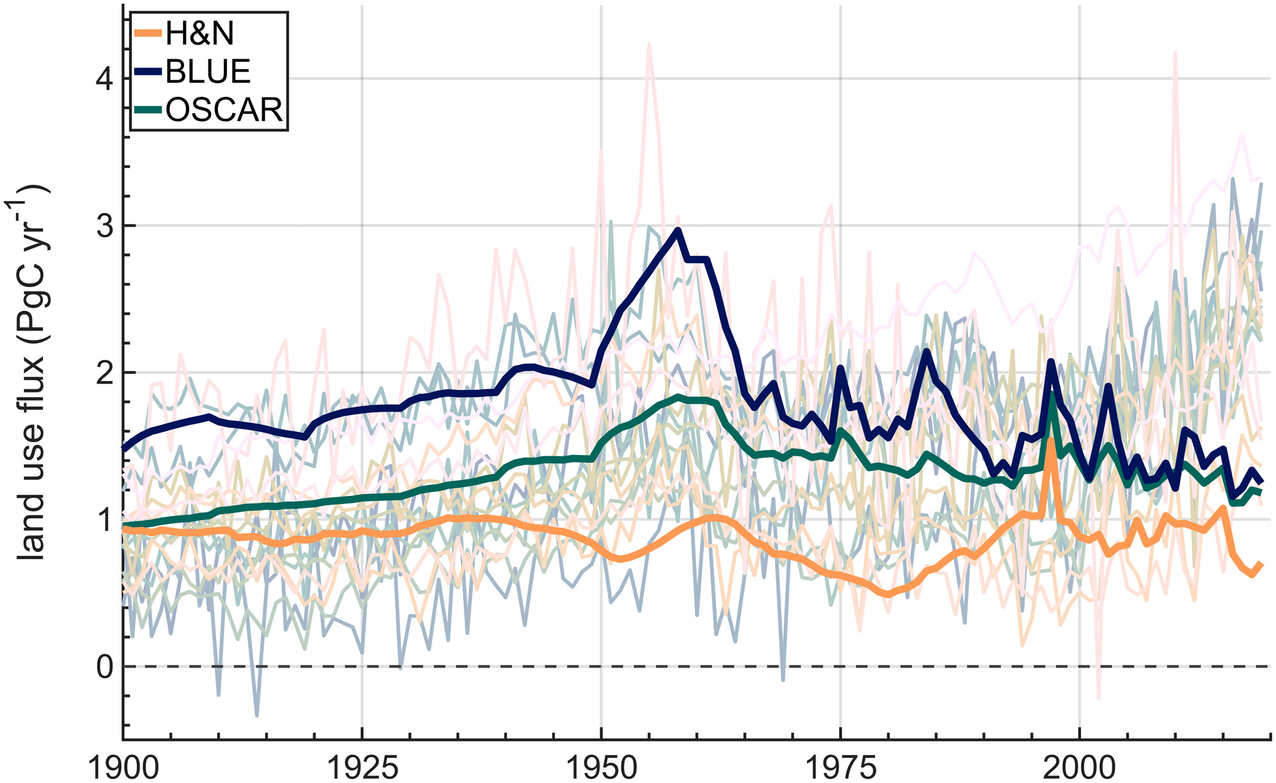
Using the atmospheric CO2 growth rate to constrain the CO2 flux from land use and land cover change since 1900
Global Change Biology, Volume: 28, Issue: 24, Pages: 7327-7339, First published: 19 September 2022, DOI: (10.1111/gcb.16396)
Notes:
Estimates of land use flux via bookkeeping based (H&N, BLUE, OSCAR, in bold) and DGVM‐based (17 estimates shown here faintly and separately in Figure S1; see Table S1 for references), all shown at annual resolution. We use the color map batlow (Crameri, 2021) in this study to prevent visual distortion of the data and to make this work accessible to readers with differing color vision (Crameri et al., 2020).
IF THIS IMAGE HAS BEEN PROVIDED BY OR IS OWNED BY A THIRD PARTY, AS INDICATED IN THE CAPTION LINE, THEN FURTHER PERMISSION MAY BE NEEDED BEFORE ANY FURTHER USE. PLEASE CONTACT WILEY'S PERMISSIONS DEPARTMENT ON PERMISSIONS@WILEY.COM OR USE THE RIGHTSLINK SERVICE BY CLICKING ON THE 'REQUEST PERMISSIONS' LINK ACCOMPANYING THIS ARTICLE. WILEY OR AUTHOR OWNED IMAGES MAY BE USED FOR NON-COMMERCIAL PURPOSES, SUBJECT TO PROPER CITATION OF THE ARTICLE, AUTHOR, AND PUBLISHER.

